Slide 1
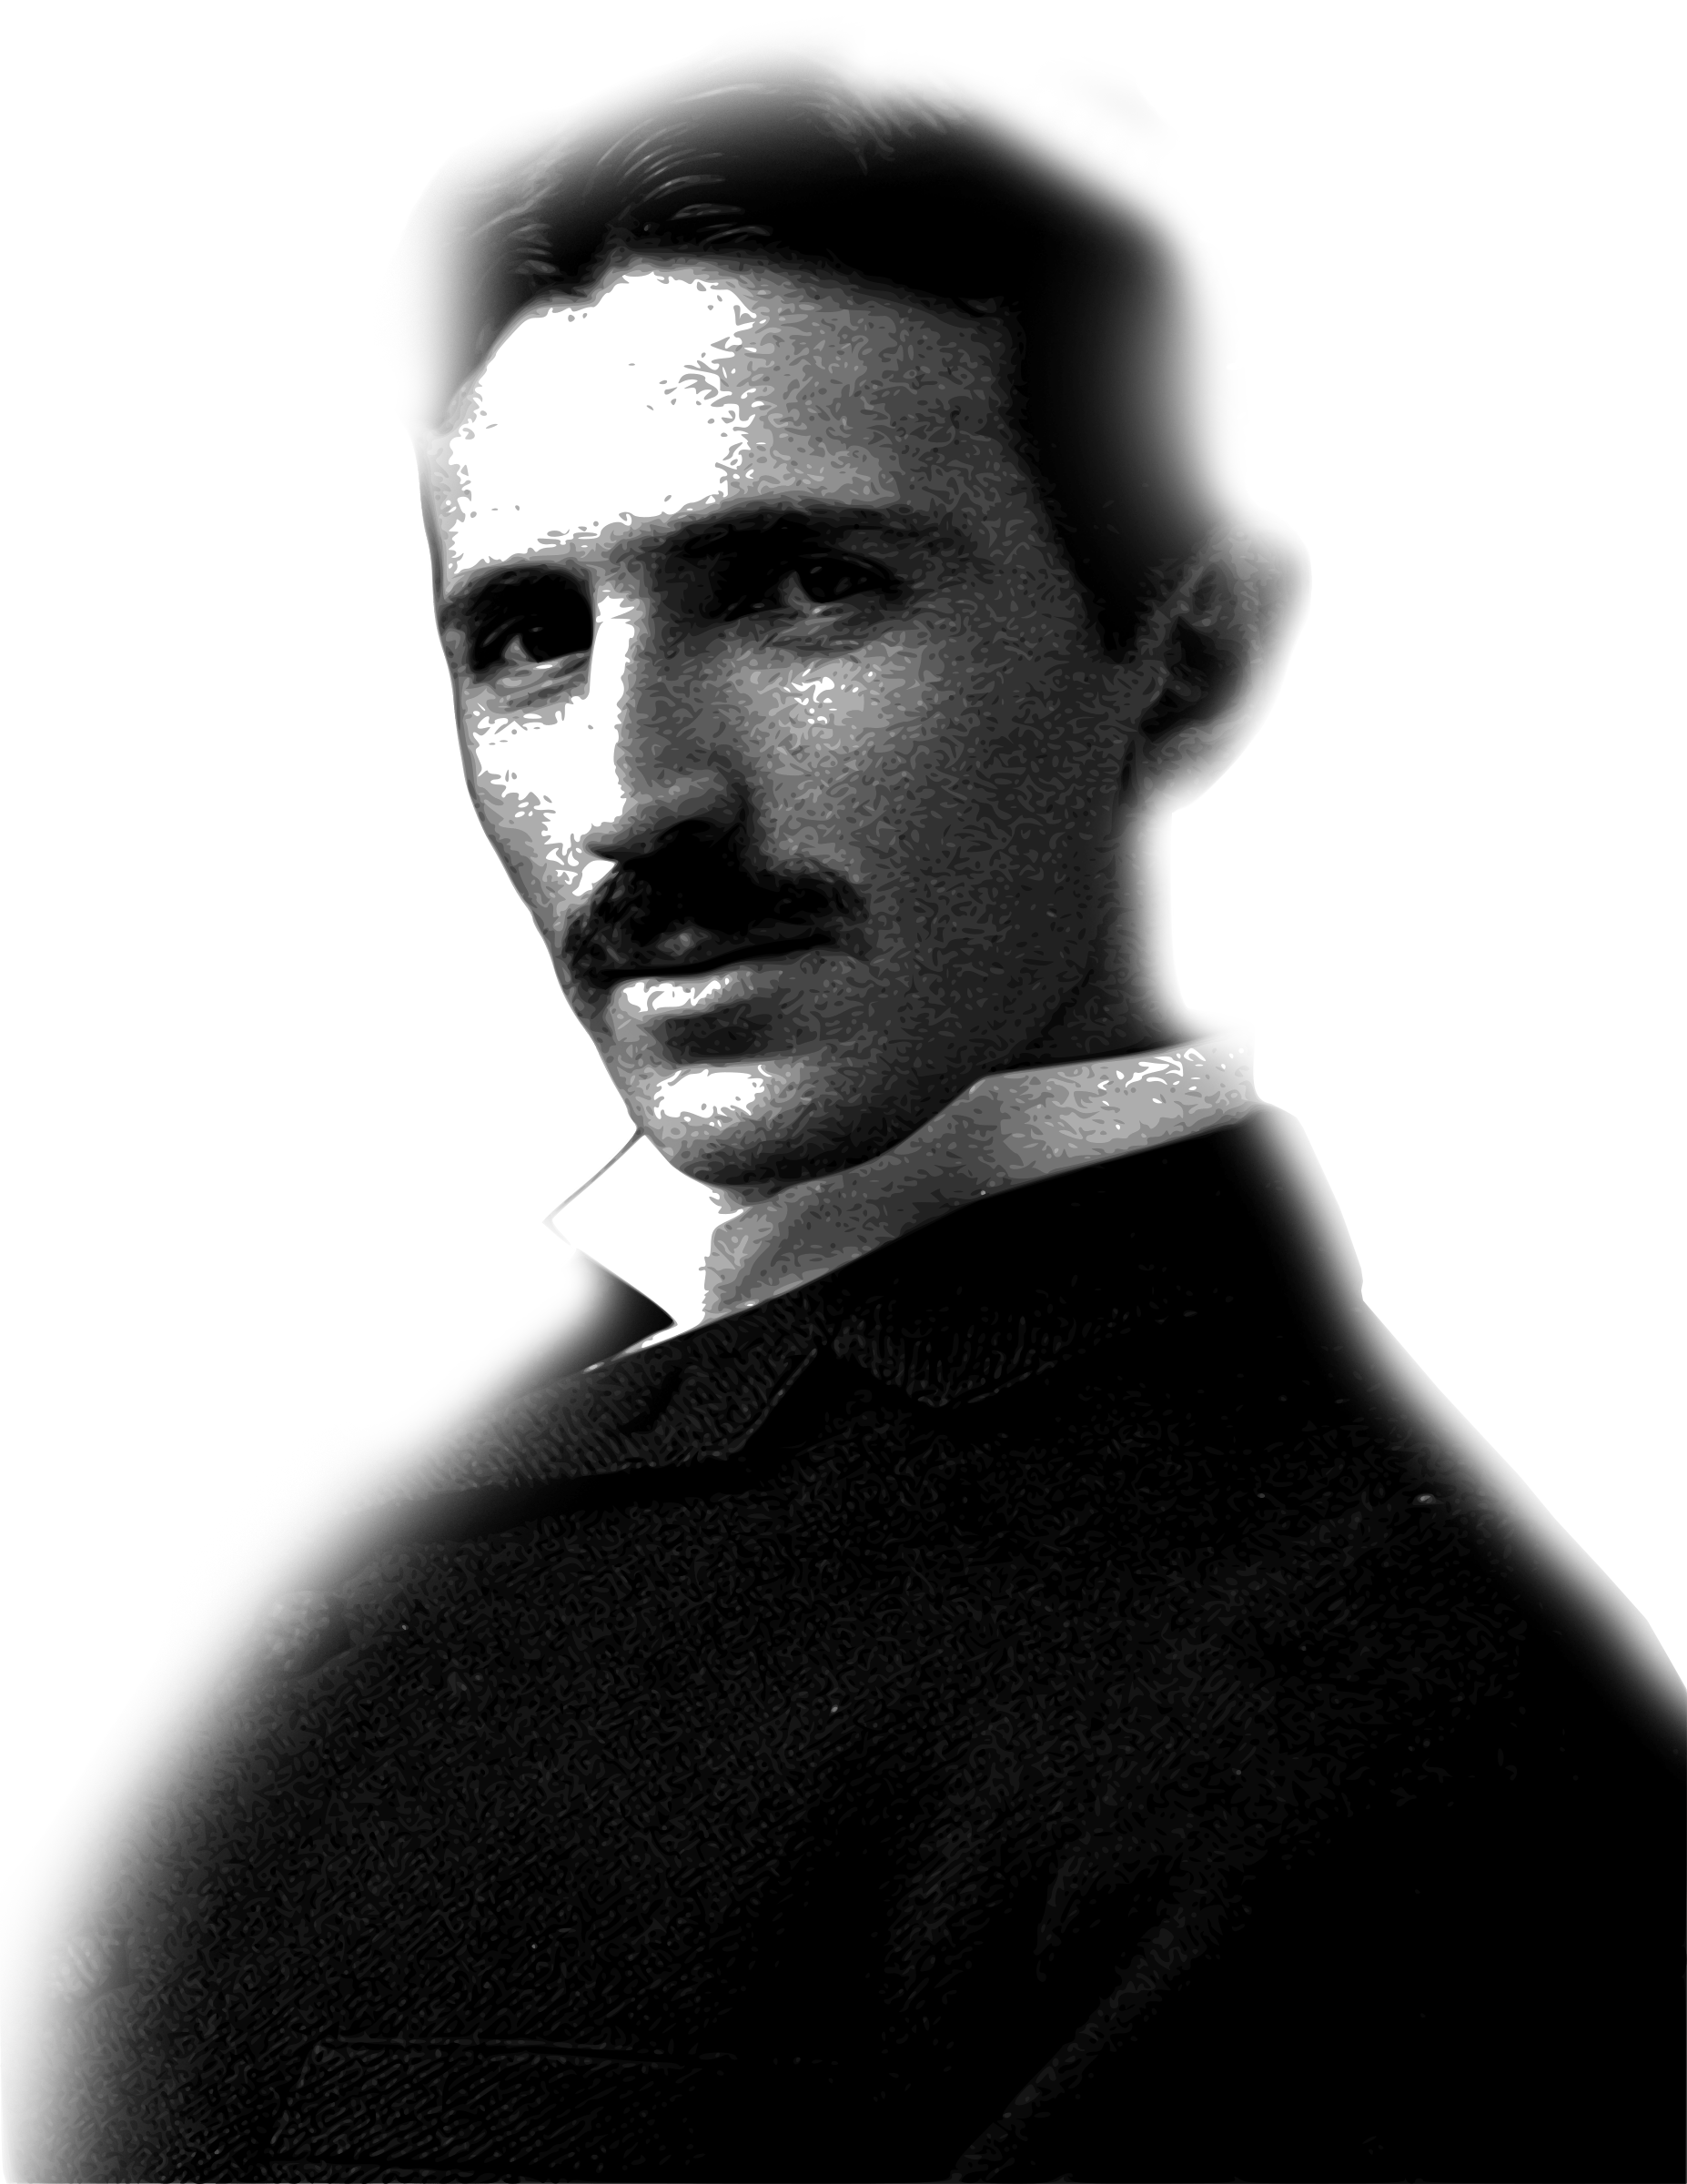
If your hate could be turned into electricity, it would light up the whole world.
— Nikola Tesla
Futurist & Electrical Engineer
Template by VegaSlide.com – Get your professional PowerPoint design for FREE

Slide 2
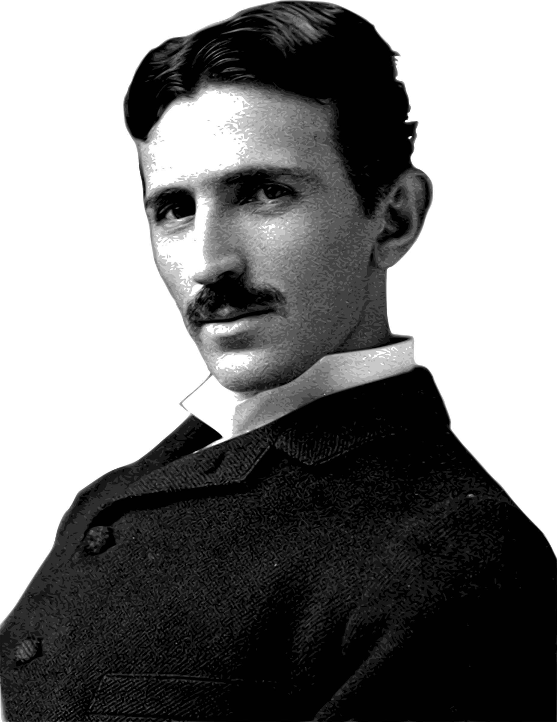
If your hate could be turned into electricity, it would light up the whole world.
— Nikola Tesla
Futurist & Electrical Engineer
Template by VegaSlide.com – Get your professional PowerPoint design for FREE

